Slide 1
Face Mask Detection Using Convolutional Neural Networks (CNN)
Presented by
A.Abhinay - R170441
V.Harikrishna - R170488

Slide 2
Overview Of Presentation
Abstract
Objective
Introduction
Deep Learning
Convolutional Neural Networks
Implemetation of Model of Project
Preparing dataset
Importing necessary libraries
Train the Neural Network model
Mask detection Process
Results
Conclusions

Slide 3
Abstract
Corona virus sickness has become a big public health issue. Because of its contact-transparent
characteristics, it is rapidly spreading. The use of a face mask is among the most efficient methods
for preventing the transmission of the Covid-19 virus.
Wearing the face mask alone can cut the chance of catching the virus by over 70%. Consequently, World HealthOrganization (WHO) advised wearing masks in crowded places as precautionary measures.
Because of the incorrect use of facialmasks, illnesses have spread rapidly in some locations. To solve this challenge, we needed a reliable mask monitoring system.
Numerous government entities are attempting to make wearing a facemask mandatory; this process can be facilitated by using face mask detection software based on AI and image processing techniques.
It will be simple to distinguish between persons having masks and those who are
not having masks using all of these ways. The effectiveness of mask detectors must be improved
immediately.

Slide 4
Objective
To enforce the mandate for wearing masks in public places following the COVID – 19 pandemic
To effectively provide a working model for accurate mask detection
To utilize image processing approaches to identify the presence of mask on face
To develop an efficient computer vision based System focused on the real time automated monitoring of people to detect face mask in public faces.

Slide 5
Introduction
In this project , we propose a Face mask detection project which consists of 2 phases, namely training and deployment.
The first stage detects human faces , while the second phase uses the deep learning to firstly, identify the ROI(Region Of Interest) being the person’s face and secondly classifies the faces detected in the first stage as either “Mask” or “NO Mask”.
It will draws the boundary of the colours either green or red depending on the output.
The project can give accurate results if we set up with a CCTV camera to track people without masks to ensure the safety and wellbeing of others, thus help controlling the spread of the virus.

Slide 6
Deep Learning
Deep Learning is an AI function that mimics the working of the human brain in processing data for use in detecting objects, recognizing speech, translating languages, and making decisions.
Deep Learning AI is able to learn without human supervision, drawing data that is both unstructured and unlabelled.
Neural Networks are layers of nodes, much like the human brain is made up of neurons. Nodes within individual layers are connected to adjacent layers. The network is said to be deeper based on number of layers it has.
In artificial neural network, signals travel between nodes and corresponding weights.

Slide 7
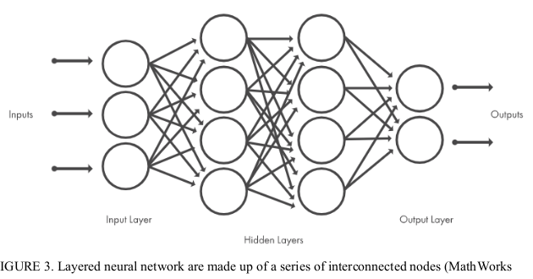

Slide 8
A heavier weighted node will excert more effect on the next layer of nodes. The final layer compiles the weighted inputs to produce an output.
Deep Learning systems requires powerful hardware because they have a large amount of data being processed and involves several complex mathematical calculations.
Automatic learning feature of deep learning at multiple levels of abstraction allow system to learn complex functions mapping the input to the output directly from data.
In this, Face mask detection is built using Deep Learning technique called as Convolutional Neural Network(CNN).

Slide 9
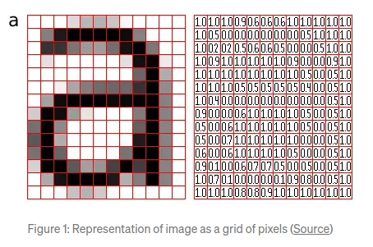
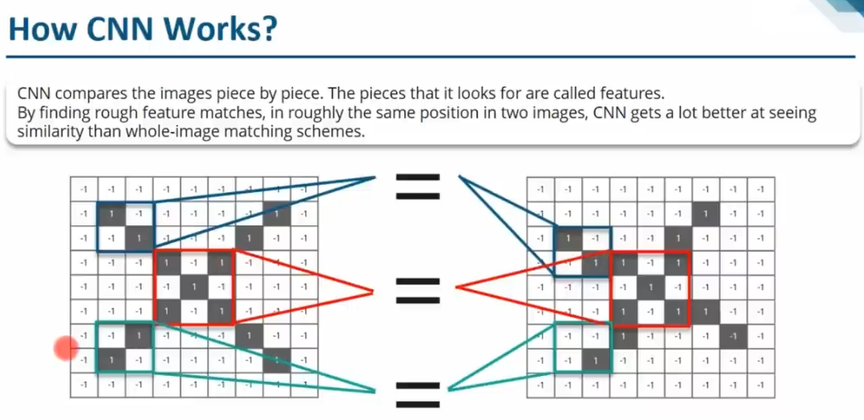
What is CNN...?
Convolutional neural networks used primarily in image classification applications.
It can detect features and patterns within an image, enabling tasks, like object detection or recognition.
CNN is also known also known as “ConvNet”, specializes in prosessing the data that has grid like topology, such as image.
A computer understands an image using numbers at each pixel

Slide 10
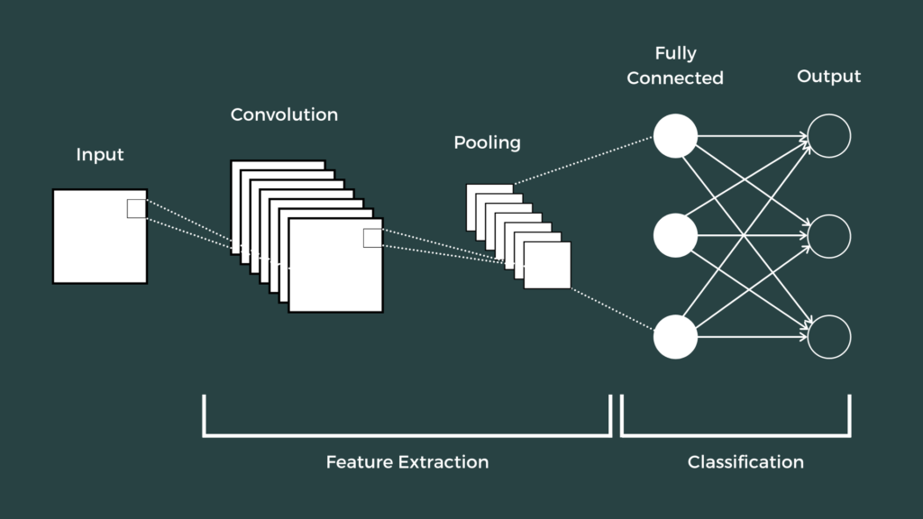
What is CNN...?
CNNs, like neural networks, are made up of neurons with learnable weights and biases. Each neuron receives several inputs, pass it through an activation function and responds with an output.
In more detail the image is passed through a series of layers as follows:
Convolution layer
Pooling layer
Fully connected layer

Slide 11
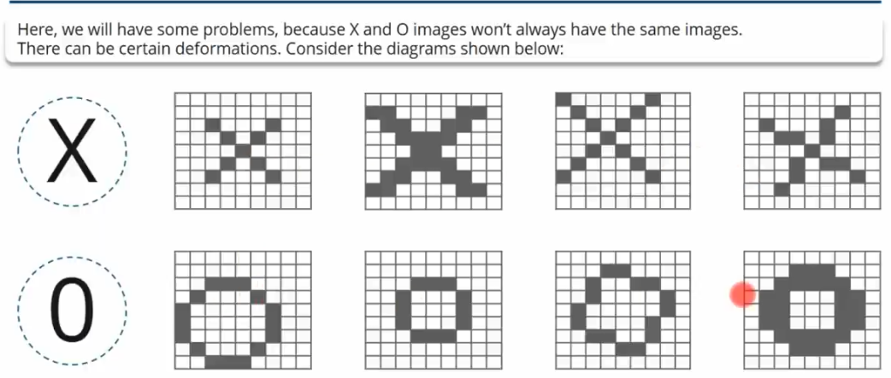

Slide 12

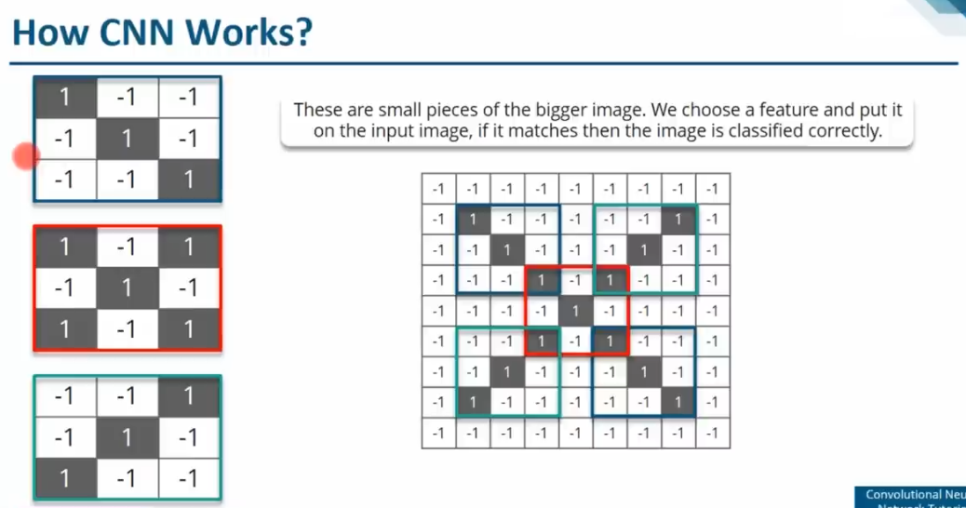
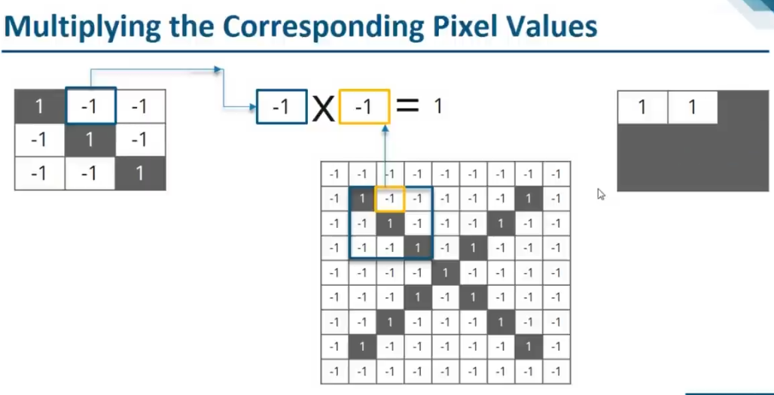
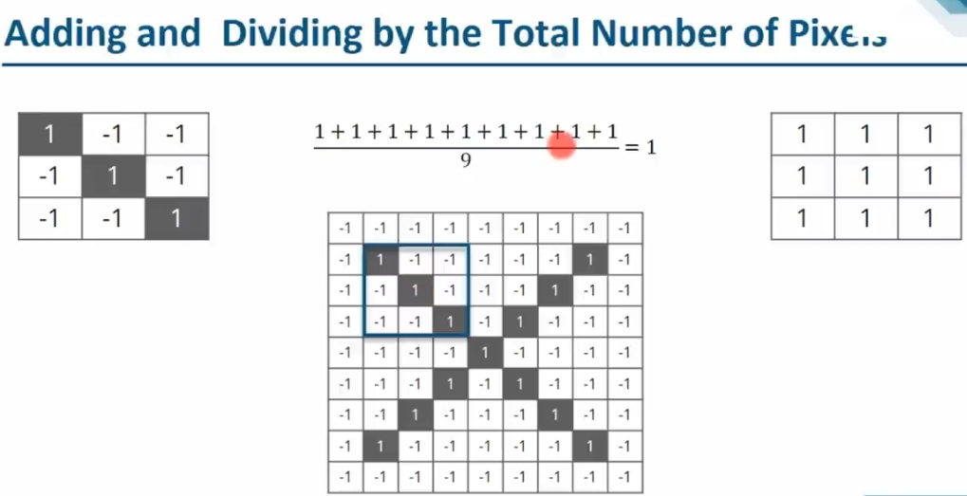
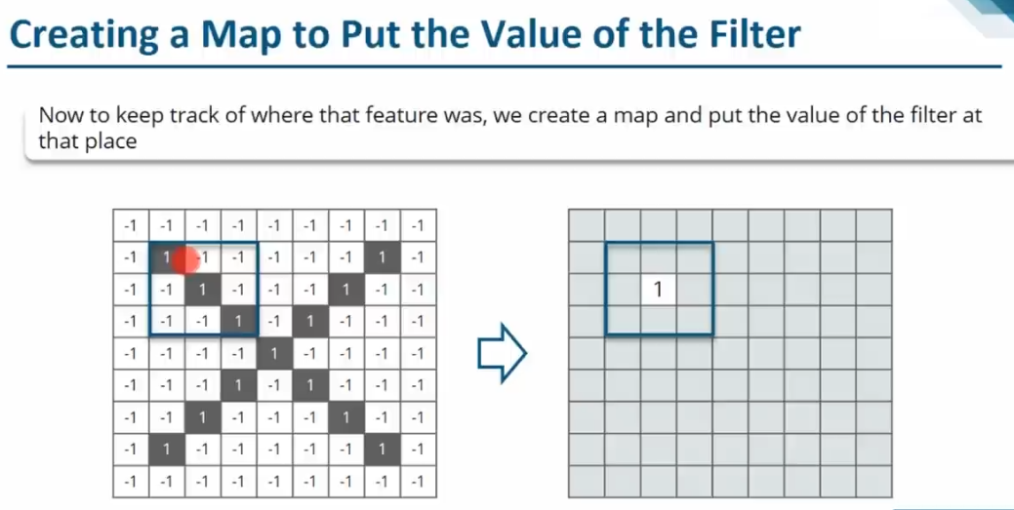

Slide 13
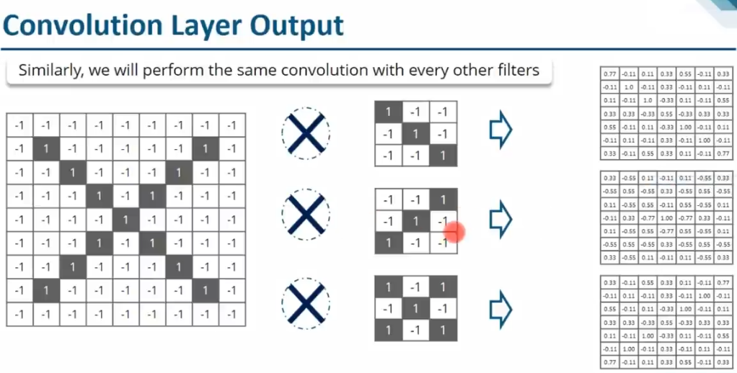

Slide 14
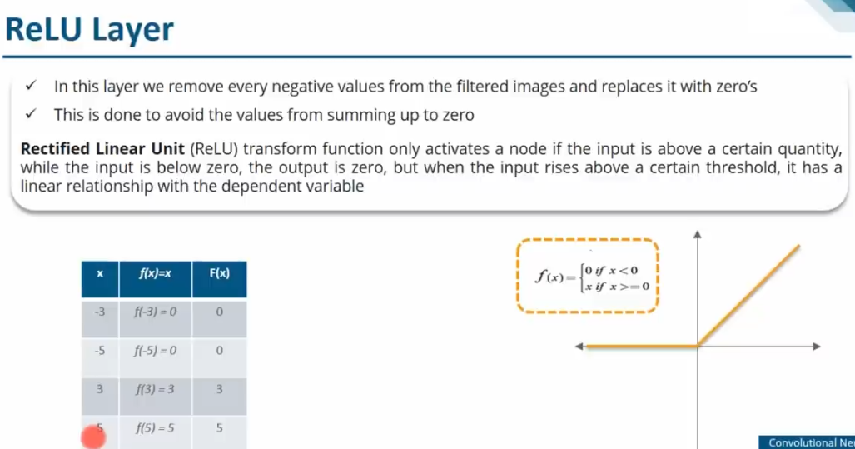
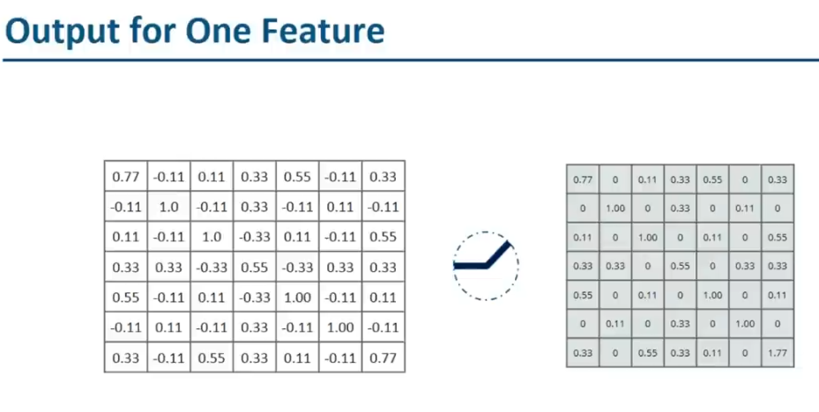
Relu Layer

Slide 15
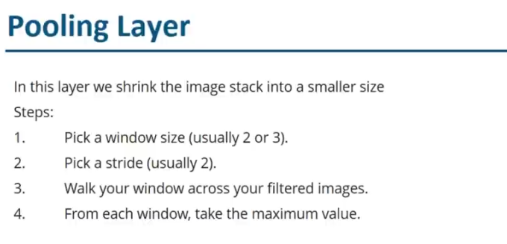
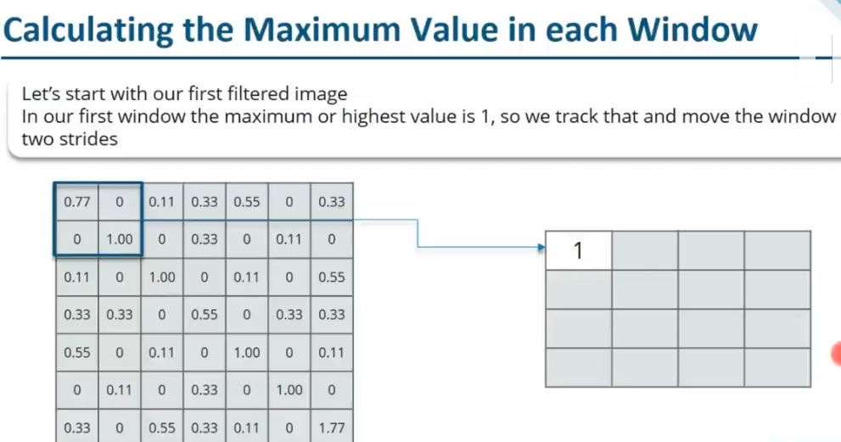
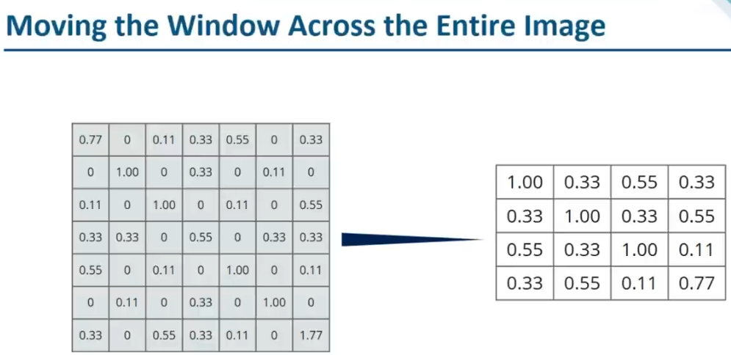
Pooling Layer

Slide 16
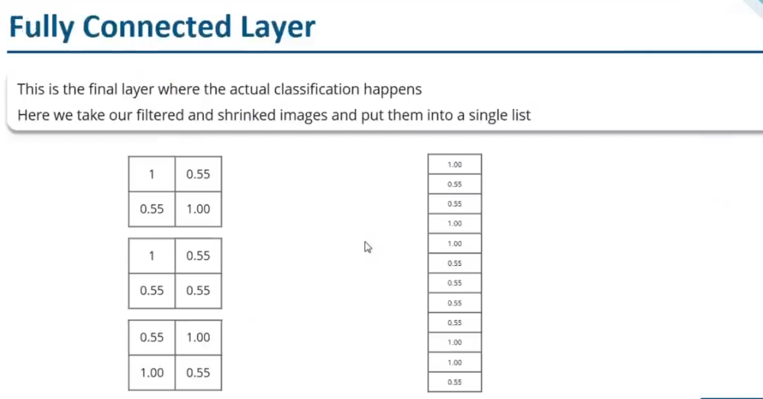
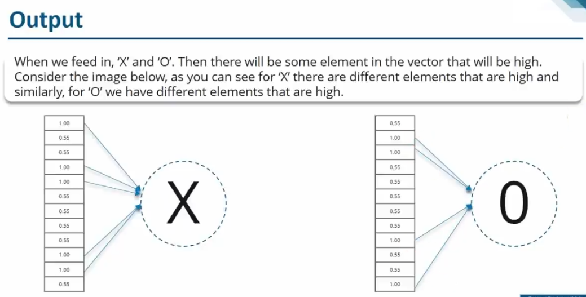
Fully Connected Layer

Slide 17

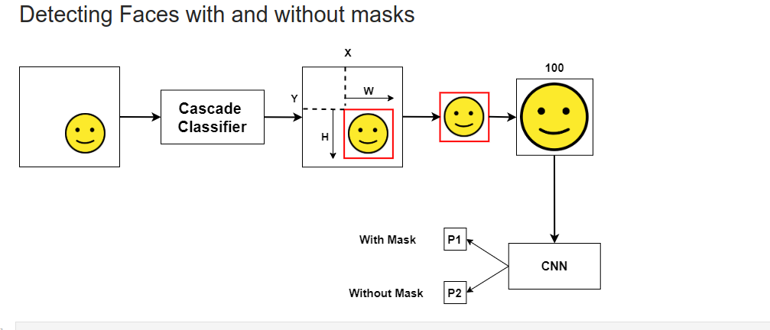

Slide 18
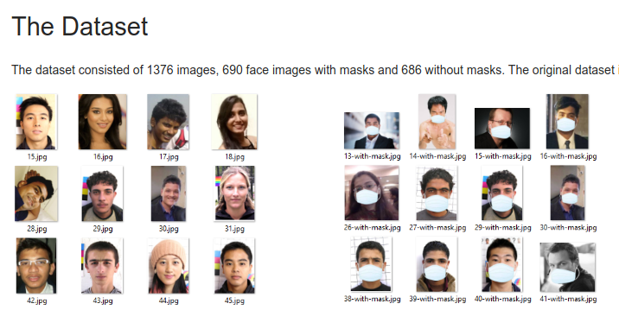
Data Pre-Processing

Slide 19
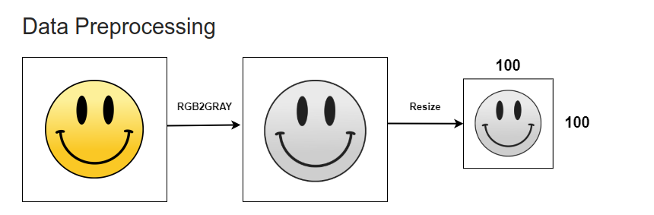

Slide 20
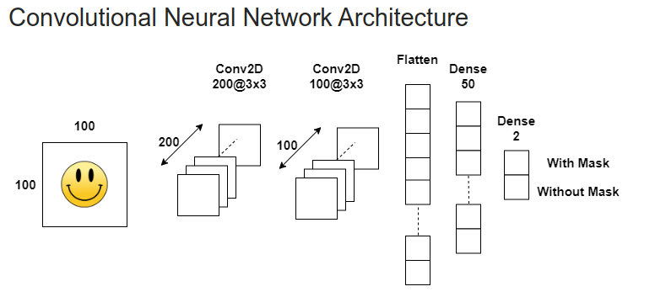
Training CNN

Slide 21
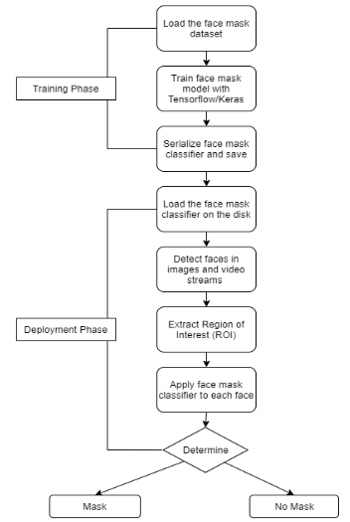

Slide 22
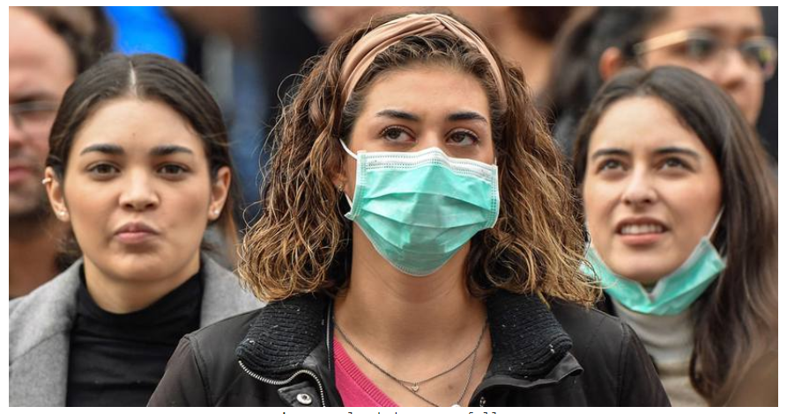
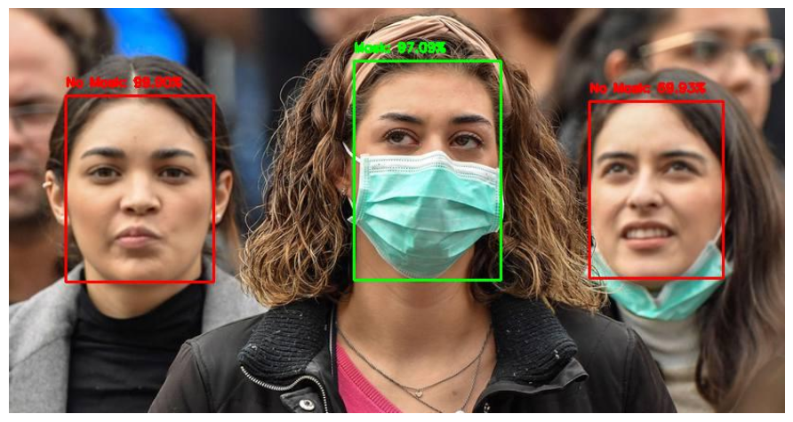
Detecting Faces with and without mssks

Slide 23
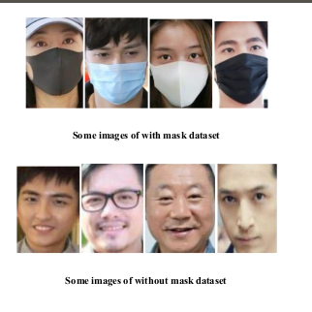
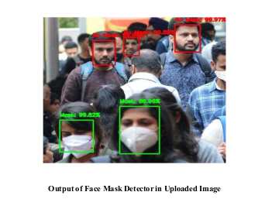
Results
We Created a facemask detector using Deep Learning. We trained it to distinguish between people wearing mask and poeple not wearing a mask.
We have used cascade classifier with the Adam optimizer for the best result.

Slide 24
Advantages
Public places like Bus stand, Air ports and Railway stations.
Offices and Educational Institutions.
BENIFITS
Cost Effective
Restrain COVID-19 Pandemic
Life saving

Slide 25
Future Scope
Can be implemented as mobile application.
Can be developed as API

Slide 26
THANK YOU

